Slide 1
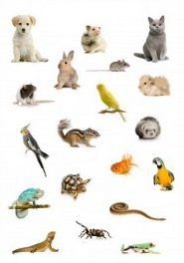
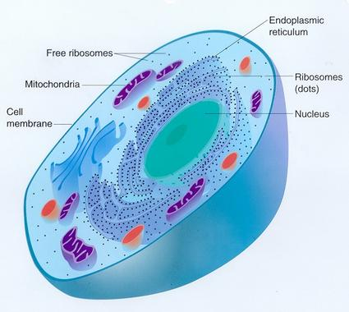
Animalia
These are organisms which are eukaryotic, multicellular and heterotrophic
Their cells do not have cell-walls.
Show body movements
Most animals are mobile.
They are further classified based on the extent and type of the body design differentiation found.

Slide 2
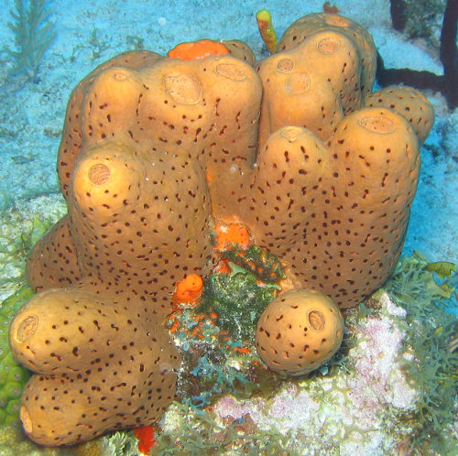
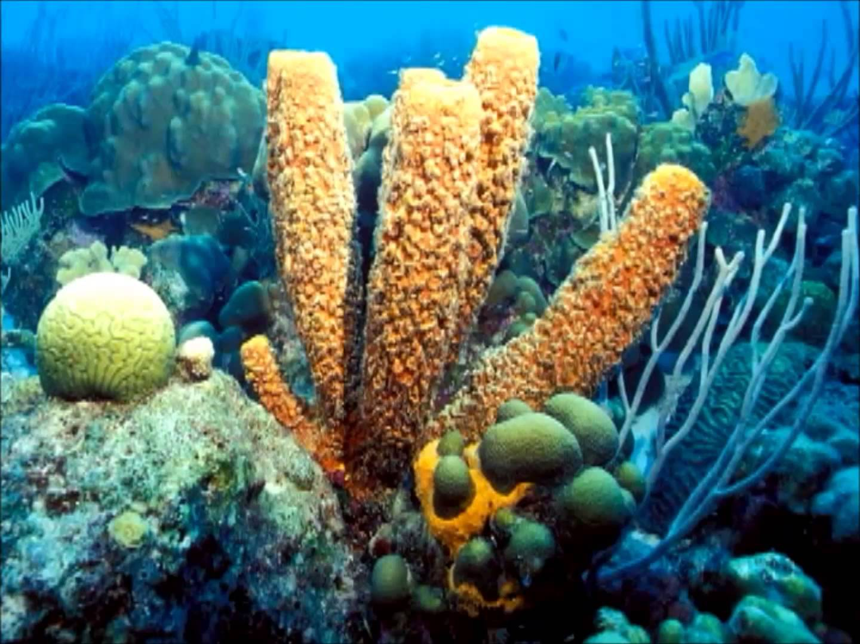
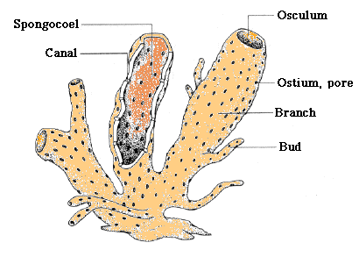
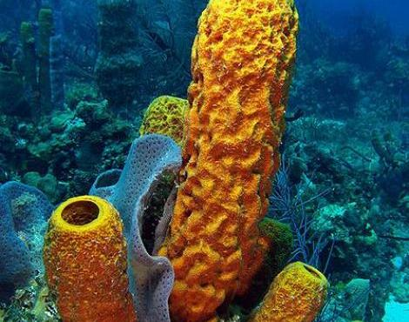
Porifera
Pori means tiny openings
The word Porifera means organisms with holes.
These are non-motile animals attached to some solid support.
Do not show movements
There are holes or ‘pores’, all over the body.
These lead to a canal system that helps in circulating water throughout the body to bring in food and oxygen.
These animals are covered with a hard outside layer or skeleton.
The body design involves very minimal differentiation and division into tissues.
They are commonly called sponges, and are mainly found in marine habitats.

Slide 3
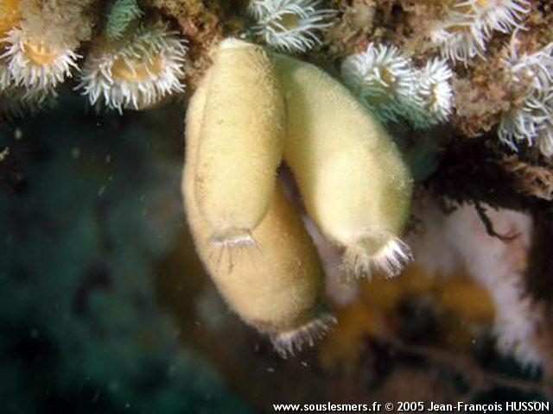
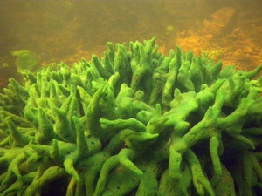
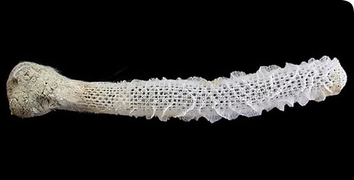
Some examples are
Euplectelea
Sycon
Spongilla

